Slide 1
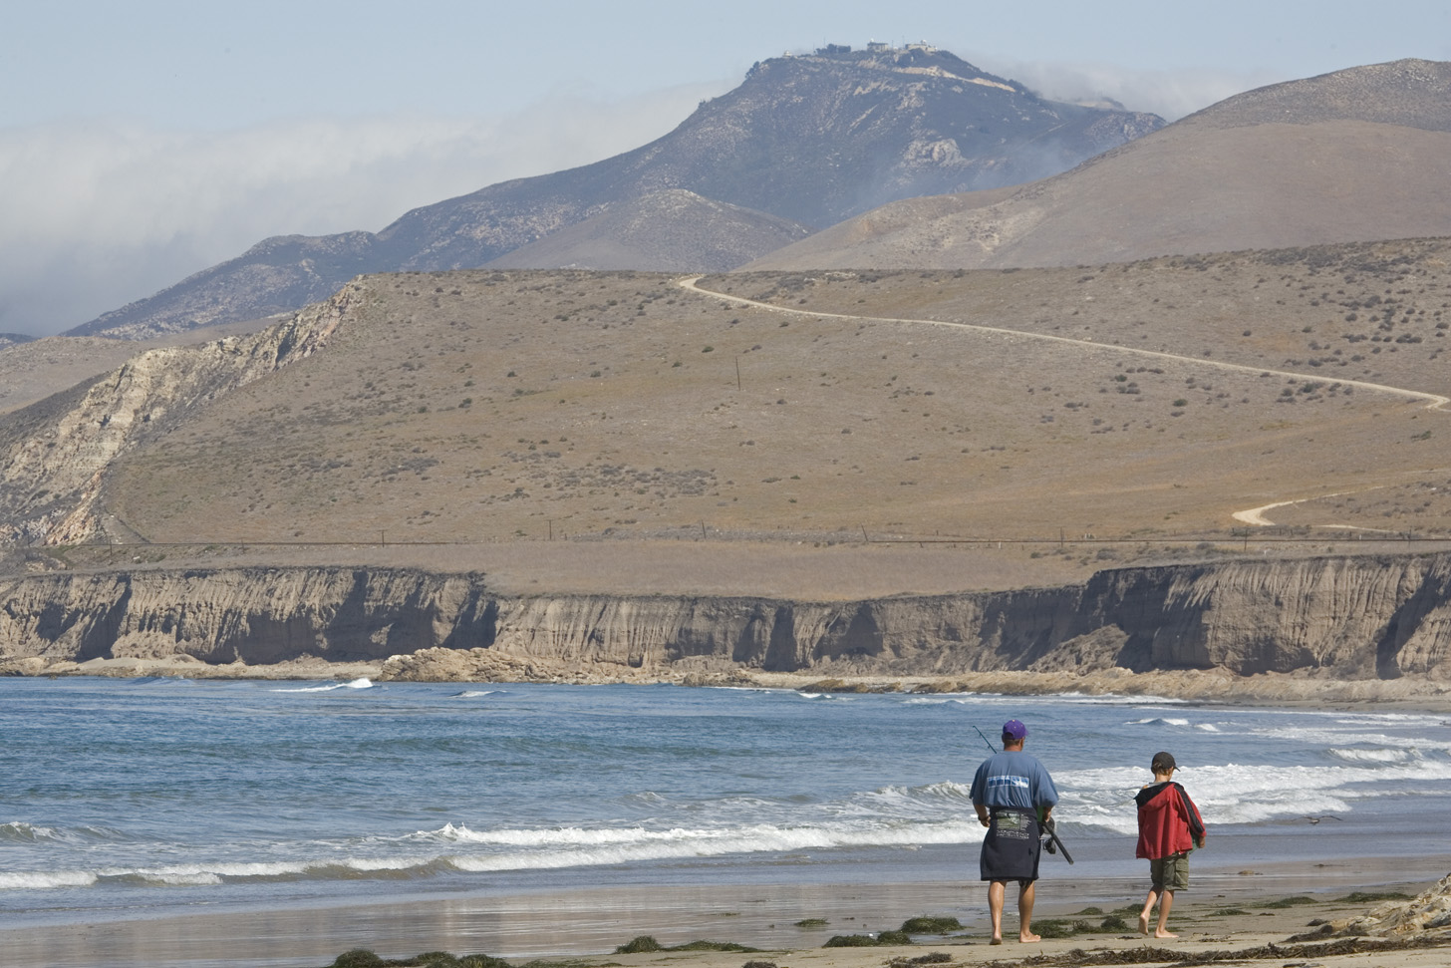

How to Build Conservation Partnerships that THRIVE
Kristin Sherwood
The Nature Conservancy
Notes:
Thanks for joining me today

Slide 2
we all work with partners we all are partners ourselves we all have experience to share we all have something to learn
Notes:
I wanted to start off with this statement because I think it sets the right tone for our morning together.
Partnership is a learning process, and I firmly believe that you learn as much through challenging partnering experiences as you do with great ones.
We are trying new approaches at TNC to become more consistent and strategic in our work with partners, but we are by no means “the experts”. I come to you today with ideas and good practices that we have learned over the last few decades of working with others – but we are constantly trying to learn and improve our practices as we go.
And likewise, I am certain that everyone in this room has as depth of partnership experience – whether it’s partnering with other parts of your own agency or organization, or if it’s partnering externally with NGOs, other agencies, companies etc. We have plenty to learn from you, and you have plenty to share with and learn from your colleagues in the room.

Slide 3

What is a Partnership?
An ongoing working relationship where risks and benefits are shared.
Notes:
Before I jump into partnership strategy, I want to define what I mean by partnership. You may think this is a no-brainer, we all know what a partner is – but the language of partnership is used very loosely – and a partner to some is just a peer or colleague to others. It makes sense to be clear about what you mean by a partner – it helps clarify expectations, it helps define roles and responsibilities, it helps you choose the right people to work with.
Now this is a traditional way to define partnership…and what is missing here, a partnership should produce results
that one partner Working alone could not achieve.
but what matters the most is NOT that you conform to this definition, but that you and your partners agree and share a definition!

Slide 4
What is a Partnership, in practice?
1. Joint creation of projects
2. Commitment of tangible resources
3. Mutual accountability
Notes:
That was a very general definition. So to put it into more practical terms, what it implies that EACH partner needs to commit to three things:
First, Joint creation of projects – you will each naturally have your own independent objectives in any partnership project, and it’s important to value those individual interests – they are what keep you at the table! But there needs to be common ground, and shared benefit from the work for it to be considered a true partnership.
Second, Resource can mean many different things – money is only one. Other kinds of resources connections to important people, technical expertise, equipment, field sites and so on…
Third, Mutual accountability – or shared risk. You’re all in it together and will collectively reap the rewards or consequences.

Slide 5
Lower Intensity/informal Higher Intensity/formal
Shorter-term, informal relationships
Longer-term effort around a project or task
More durable and pervasive relationships
Shared information only
Some planning and division of roles
New structure with commitment to common goals
Separate goals, resources, and structures
Some shared resources, rewards, and risks
All partners contribute resources and share rewards and leadership
EX: Associations,
networks
EX: Coalitions,
project teams
EX: Joint ventures
Notes:
So, if they are not true partners, who are?
Even in cases where a group meets those three criteria – all partners are still not created equal! No partnership is ever the same, but there are levels of intensity of how you work together, and being able to explicitly define the kind of relationship you want or need to have is critical in creating clarity around expectations and roles.
Informal /low intensity relationship with other organizations does not require shared mission, structure or planning. Information is shared only about the subject at hand. Each organization retains authority and keeps resources separate so the risk is of this kind of relationship is low. Some examples of this kind of relationship is an association or a network.
One step further into the spectrum would likely include planning around role division. In some cases this can be done with a handshake or documented in a non-binding way. In other instances more formal documentation is used to codify the roles and responsibilities of each partner. This kind of partnership requires deeper communication and coordination.
And at the end of this spectrum, you will find a formal, more intensive partnership. These relationships take a lot more time and energy and require a strong commitment to shared goals, but are often necessary for advancing long-term conservation goals.
Again, these categories are fluid, and a partnership might cycle through all of them in various stages of it’s evolution. the point here is that it is worth the time to step back and define with some degree of precision – what you mean by partnership and be sure that your partners share or agree to that definition.

Slide 6
A Strategic Approach to Partnership
PREPARE
SELECT
CONCLUDE OR
ADAPT
Strategic Approach to Partnerships
NEGOTIATE
MEASURE
MANAGE
Notes:
This diagram illustrates a strategic approach to building, maintaining and concluding partnerships.
There are six steps, as you can see, and I will walk you through each of the steps so you can get a sense for what they entail. This diagram is not something TNC made up - it’s drawn from a few different models we found in the partner relations arena, and adapted to fit the best practices we’ve learned from experience working with partners around the world.
And just to note – what am proposing here is NOT a one-size fits all approach – you may jump directly from one step to the next, but in other circumstances you might skip a step, repeat a step and so on. There is no right way to work with partners, and all partnerships are different. But with that said, we think that this approach is general enough and robust enough to be applied – with adjustment – to almost any situation – from non-profit pt to govt’ to community-based partnerships.

Slide 7
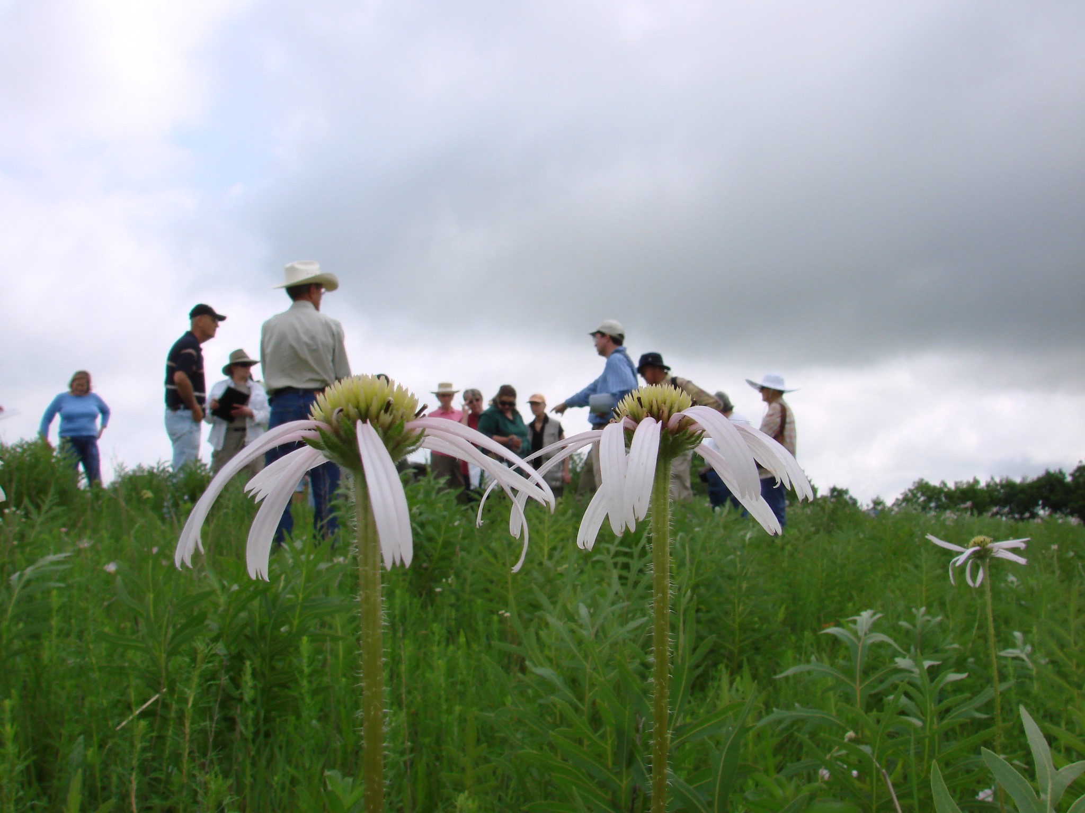
Preparing to partner
1
PREPARE
Notes:
First step is – to ask the question - do we even need to partner?
Not rhetorical! Most high level conservation strategies involve partners, but there is reason to be thoughtful about your decision to partner – you have to ask yourself if is really necessary to help achieve your goals and make sure that it advances your strategy in a definable way.
Partnering for the sake of partnering will only lead to poor outcomes.

Slide 8
To Partner or Not to Partner?
1
PREPARE
1
PREPARE
New ideas
Expanded scale
Exchange technical expertise
Provide, receive, or expand funding
Share data
Access to new constituents
Leverage influence
More time & cost upfront
Increased coordination & communication needs
Investment in maintenance
Increased risks: unproductive relationships, partners not meeting goals/expectations, etc.
Changing organizational visions and strategies
Notes:
When you are faced with a decision to partner, there are PROS and CONS to evaluate, and again – don’t skip this step. Being certain of strategic alignment and aware of the potential pitfalls is critical in making the right decisions.
Here are some good reasons for entering into a partnership.
And some potential issues to be aware of – some of these came up when we talked about challenges in partnership a few minutes ago.
This is just an abbreviated list – and I am sure you can think of others – but it’s important to think beyond the gloss of a new potential partnership and really consider all of the potential angles before you dive in.

Slide 9



Partnering as an Art? A Science?
1
PREPARE
Insight / imagination
Vision
People skills, i.e. flexibility, humbleness
Relationship building
Personal engagement
Technical knowledge
Negotiation/mediation/facilitation
Critical analysis / thinking
Evaluation
Admin / project / financial management
Notes:
Another thing you’ll want to think about when preparing to partner is that successful relationships takes a range of skills – some may come naturally, and others may need to be acquired. It’s important to be aware of these when you’re assembling your internal team – and later, thinking about potential partners.
There are two complementary aspects: the ‘soft skills’ - Art and the more technical or ‘hard skills’ of Science; they’re both essential in day-to-day work of partnering.
STAND UP if you think your strength is on the “art” side? What about the “science”? Who is a perfect balance?
You may have a natural inclination to one of these, the challenge as you prepare to partner is building your capacity in the other or bring in others to balance the approach.

Slide 10
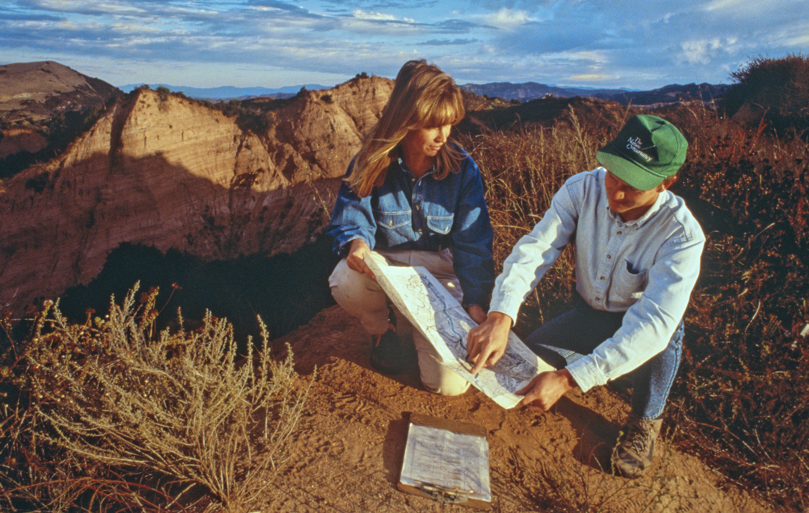
Selecting Partners
2
SELECT
Notes:
The next step is focused on scoping and identifying partners. What it really means is being thoughtful – not just choosing the organizations that you have worked with before.
It makes sense to do a rigorous job of scanning the field, and doing your due diligence to make sure that you’re finding the right fit with the least amount of risk.
We all can think of times when we chose the wrong partner…Is there anyone here who can honestly say they have never made a poor choice of partners? Please raise your hand! High!!

Slide 11
Partner Selection Process
2
SELECT
Define Objectives
ID Key Criteria
ID Orgs and Gather Info
Narrow the List
Make a Decision
Notes:
Here is a set of general steps follow to help you make an informed decision about your partner choice –
Defining the OBJECTIVES for your project
Identifying KEY CRITERIA for what you want in a partner in order meet your objectives (and the gaps in your own orgs expertise)
ID potential orgs and gather information about them,
NARROW the list through consultation with your team,
MAKE A DECISION.

Slide 12
Scoping Checklist
2
SELECT
Does the partner have… | Current status | Further actions
A good track record?
Good standing in the field/sector?
Wide ranging contacts and influence?
Skills and competencies that compliment your org/other partners?
Sound management and governance structures?
A record of financial stability?
A stable staff group?
Notes:
This kind of assessment form helps you ask systematic questions of any potential partner to ensure a good fit with the goals and needs of the partnership – and ensures that you’re making a defensible decision that is made on solid facts.
Current status – what you know so far, reliability of your info sources
Further action – note where more info is required, remaining concerns

Slide 13
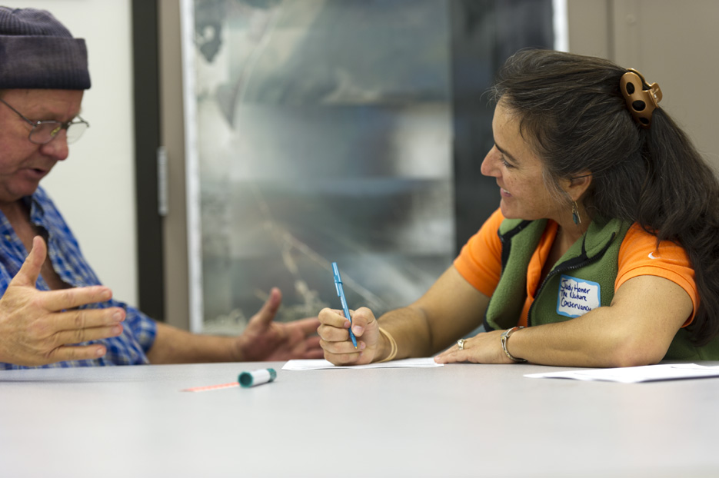
Negotiating Agreements
3
NEGOTIATE
Notes:
NOW You’ve chosen the partner or set of partners that you want to work with, and so it’s time to seal the deal and document the partnership.

Slide 14
3
NEGOTIATE
Spectrum of Partnership Documentation
More Formal:
Memorandum of Agreement
or Understanding
Most Formal:
Partnership
Agreement
Joint Venture
Less Formal:
No documentation
Oral Contract
Notes:
You may need more legal formality if it’s a more intense project where money and activities are being shared. Or if you’re doing very simple coordination of work, you might not need to be so formal.
And as your partnership evolves and changes over time, you will always want to come back and re-evaluate whether you have adequate documentation for your purposes.

Slide 15
Partnership Agreements
3
NEGOTIATE
Goals and expectations
Roles and responsibilities
Joint work plan
Financing and resource contribution
Fundraising
Communications (including media)
Decision-making structure
Partnership review and measurement
Long-term planning
Exit strategy
Notes:
Regardless of which kind of agreement is for you, you will want to think through if not DOCUMENT, these kinds of things….

Slide 16
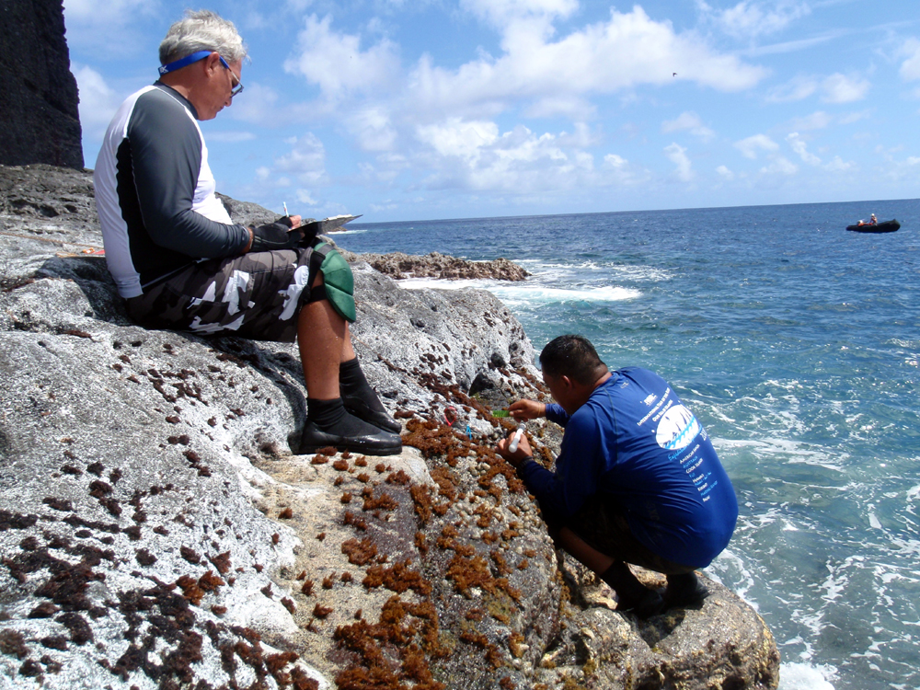
Managing the Partnership
4
MANAGE
Notes:
It may seem like the hardwork is done now – you have chosen the right partners, you have solid workplans and roles mapped out, and you have created appropriate agreements. But – of course, now the real joint work and project implementation - and you’ll be able to see if your hard work building the foundation of the partnership pays off.

Slide 17
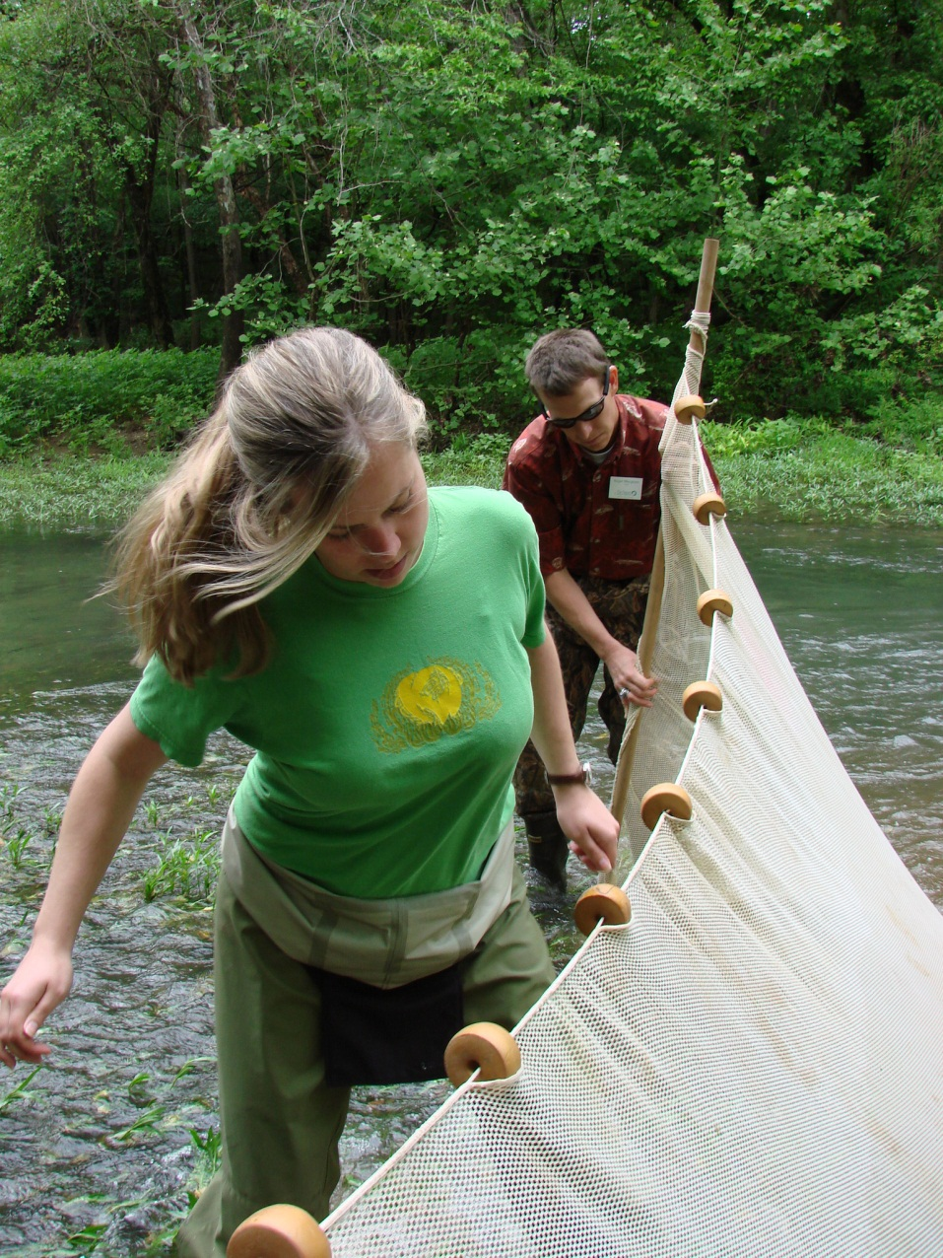
Quick Tips for Successful Collaboration
4
MANAGE
Frequent communication, regular face-to-face meetings
Take some field trips.
Designate a coordinator or point person
Get your boots muddy working on something tangible.
Notes:
Here are some very quick tips that we think help keep a partnership functioning well…
Communication of course/ IN PERSON
There is nothing like walking-the-ground to help highlight a problem or a need or an issue. Informal field trips can allow people to get to know one another as individuals rather than strangers or adversaries; to move beyond their stereotypes of one another as "an environmentalist," "a logger," or "a Forest Service ranger,
Depending on the scale and scope of your project, it is usually helpful to have someone who is on point for coordinating the effort. If this coordinating function is left to chance, tasks often fall through the cracks.
Action is motivating. Start with problems or issues that are more easily solved and that involve hands-on projects. If the collaboration is all about talking in a room, chances are good that people will slowly fade away from it.

Slide 18
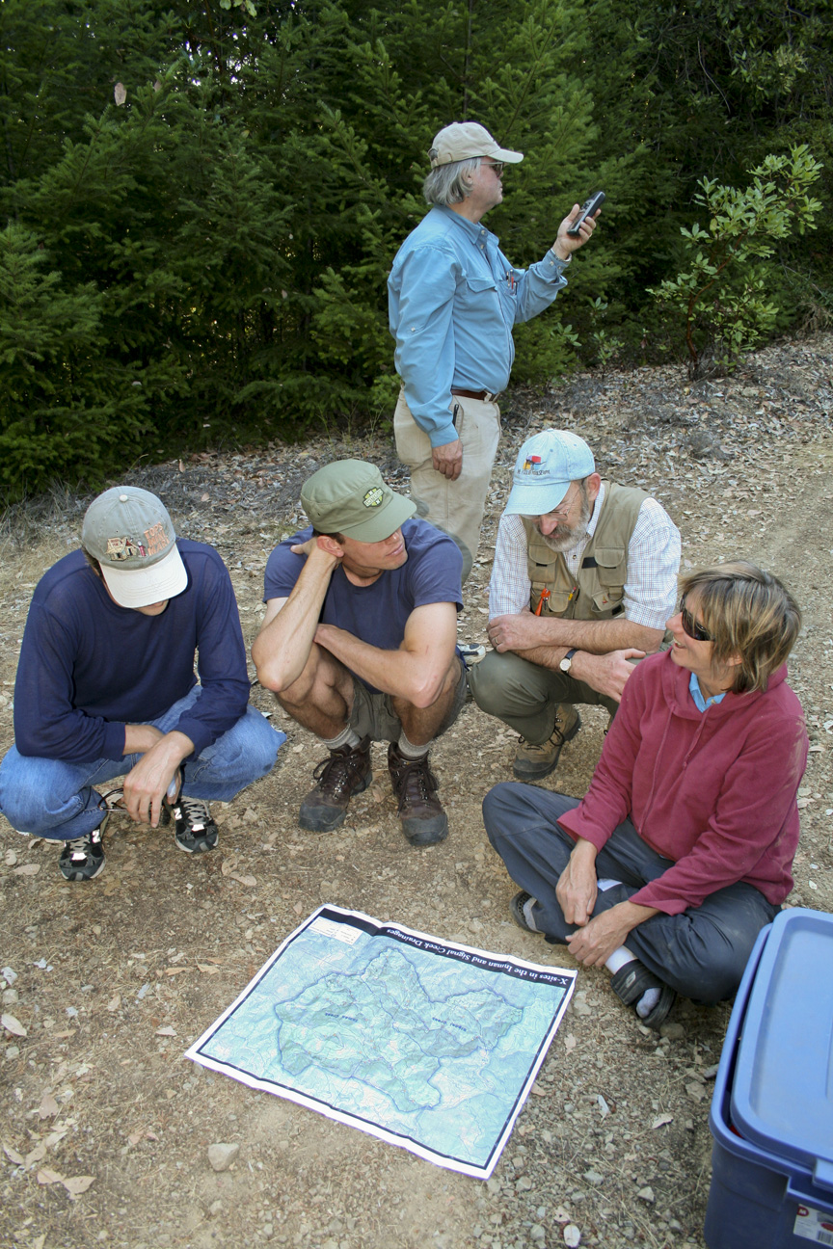
4
MANAGE
Hire the right staff and clarify roles
Joint work planning
Manage conflicts and grievances
Celebrate small successes
Notes:
The right staff – that bring both art and science skills – is critical
Joint work planning, real coordination
Managing conflicts and problems so that they don’t undermine the collaborative effort
Celebrate – keep people motivated and help people see that, even if it’s slow, progress is being make toward goals.

Slide 19
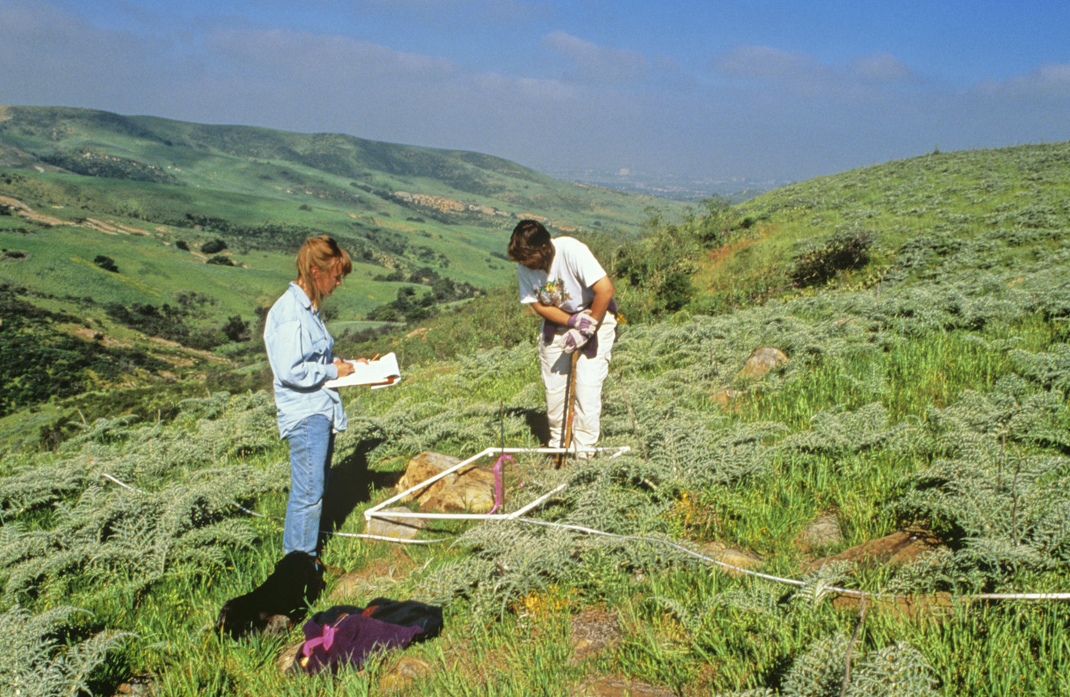
Measuring the Partnership
5
MEASURE
Notes:
In the conservation sector, we are getting better and better at monitoring progress towards our outcomes. It makes sense that we’d want to understand and measure the effectiveness and health of our partnerships as a part of that. Simple and consistent assessments of your partnership will help you understand where problems are brewing – and allow you find solutions before the whole project gets derailed.
Routine monitoring not just of your outputs and outcomes, but ALSO of the health and effectiveness of your partnership can help you keep your work on track. This kind of measurement might be new to a lot of you – but getting early clues that a partnership is faltering can allow you to make some quick changes before you actually see your conservation outcomes being impacted.

Slide 20

What to measure?
5
MEASURE
Operations
Fulfillment of commitments
Management
External communications
Transaction costs
Set up
Governance structure
Agreements
Sufficient resources
Clear roles
Right partners?
Clear review process
Partner Relations
Internal communications
Equity
Transparency
Institutional buy-in
Notes:
Here are some specific things that could be helpful to evaluate – we can separate them into three buckets – Set-up, operations and relations.
Emphasize that none of these measures take the place of understanding whether a partnership have it’s intended impacts – these are early measures that can help confirm whether you have the right framework for achieving your results.

Slide 21
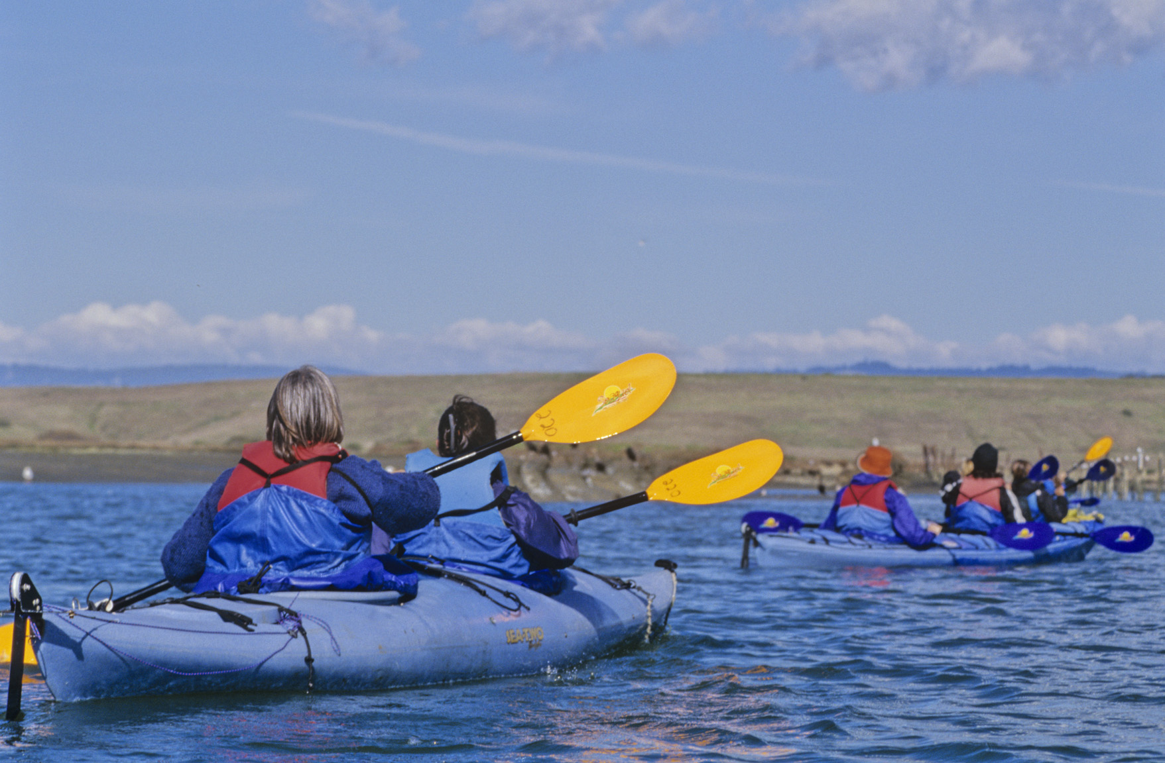
Why measure a partnership?
Predict early issues that could impact conservation outcomes
Potentially re-defining the partnership
Keeping people motivated and on-task
Changing activities & partners if required
Notes:
So again, why should we measure partnership health and effectiveness?
-predict early issues
-reshape the partnership so that it is as focused and relevant as it can be
-reenergizes people, helps them feel engaged and committed
-helps to justify any big changes that need to happen – stopping some activities, adding new partners- cycling others out
Something that should be done regularly – 6-12 months? External consultant or internal process.

Slide 22
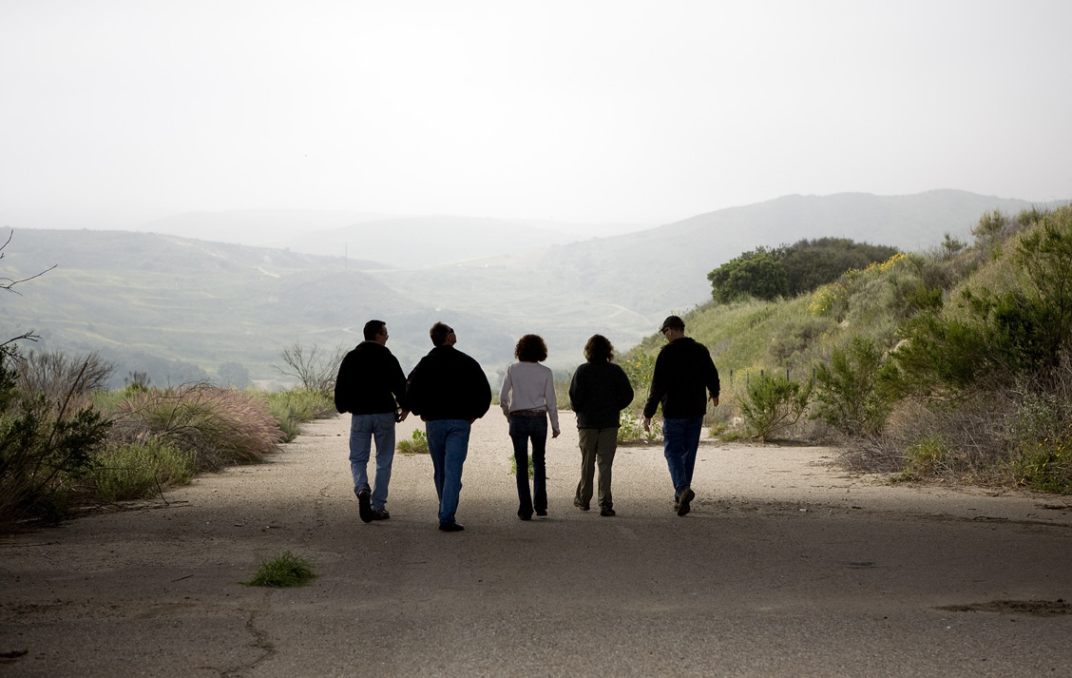
Concluding or Adapting
6
CONCLUDE OR
ADAPT
Notes:
The last stage of partnering is concluding the work or modifying it = all while sustaining outcomes for the long term. People like to say that partnerships are like marriages, and that’s true to some extent in that the same communications and relationship skills that you use in a marriage are useful in a partnership. But partnerships are not created for the sake of the partnership itself; partnerships are created around conservation goals. Every partnership will eventually end.

Slide 23
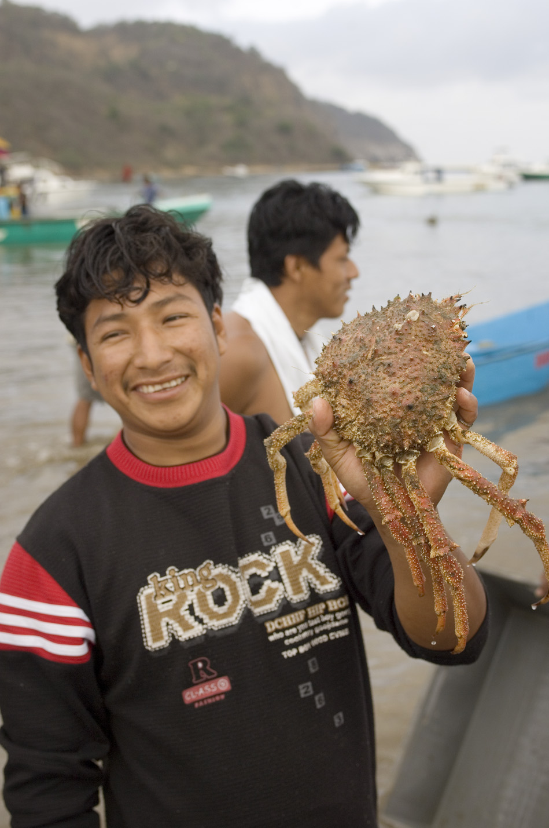
Concluding/Adapting
Tendency is to focus on the beginning, not the closure.
Most partnerships aren’t designed or meant to last long term.
All partnerships need to talk about the end at the beginning.
Notes:
23
Very few partnerships are designed to be carried on without end. But endings are critical to sustaining achieved outcomes.
Important to be in continual conversation from the beginning about building a ‘moving on’ strategy focused on how to sustain outcomes & resourcing.

Slide 24

“At some point, the relationship will be so different from the one envisioned in this partnership, it will be time for this one to end. A successful exit to this partnership will be when Big Sur Land Trust is so fully competent that it has little to ask from TNC and TNC has little to offer, and when the conservation projects of mutual interest are completed.”
- Big Sur Land Trust – TNC Owner’s Manual
Notes:
Here’s an excerpt from a partnership agreement in Big Sur, that had enough foresight to develop language that would help them know when it was time to end the partnership. ….

Slide 25
A Strategic Approach to Partnership
PREPARE
SELECT
CONCLUDE OR
ADAPT
Strategic Approach to Partnerships
NEGOTIATE
MEASURE
MANAGE

Slide 26
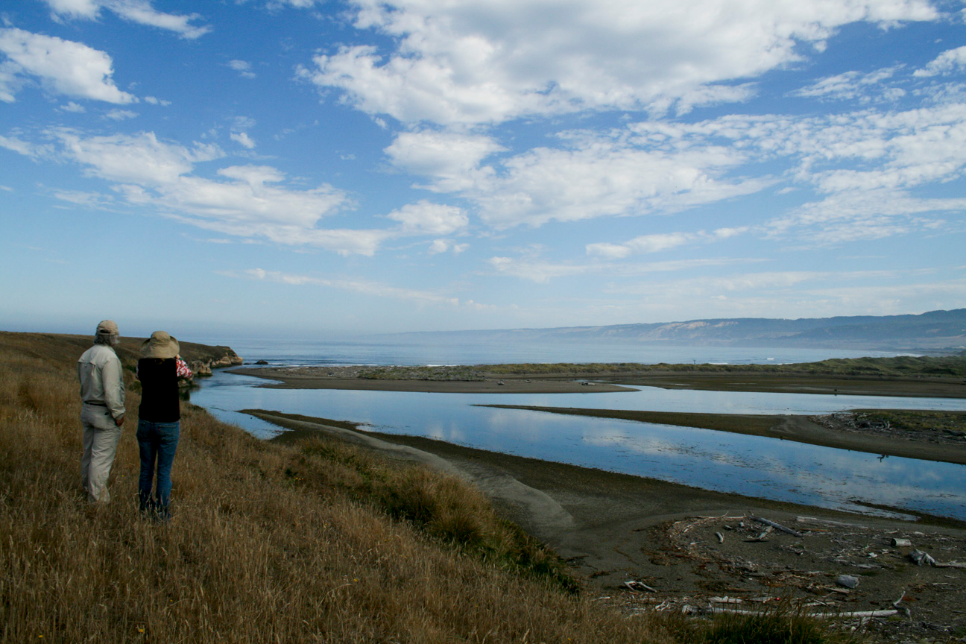
Partnering works best when groups:
•Take time to build strong working relationships
•Develop genuine concern for each other’s underlying interests
•Do more listening than talking
•Develop good communication skills at all levels
•Deal with difficulties rather than ignoring them
•Balance a flexible with a rigorous approach
•Focus on practical and sustainable results

Slide 27
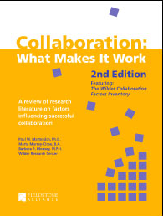
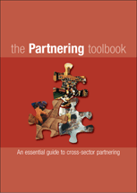
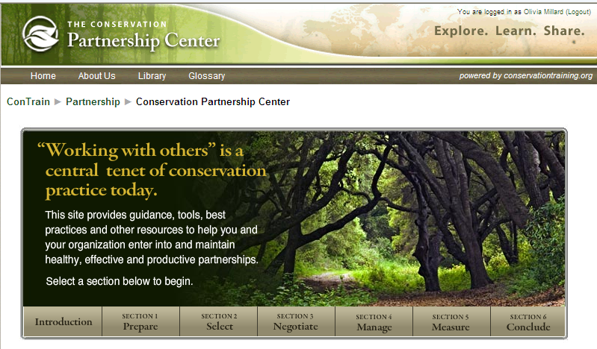
Resources
TNC Conservation Partnership Center
World Wildlife Fund – UK Partnership Toolkit
The Partnering Initiative
The Fieldstone Alliance
GOOD LUCK WITH YOUR PARTNERSHIPS!!

